Slide 1
Home Security Business Briefing for Electric Growers

Slide 2
Agenda
1
2
Executive Summary
Approach
3
4
Targeting Strategy
Initial Findings

Slide 3
1
Executive Summary

Slide 4
Introduction
Presentation on potential new home security business, data analysis and targeting strategies

Slide 5
2
Approach

Slide 6
Project Approaches
Data analytics team approaches:
Understanding the Business Problem
Analyzing the Business Problem
Creating a visual representation of your analysis results

Slide 7
3
Initial Findings

Slide 8
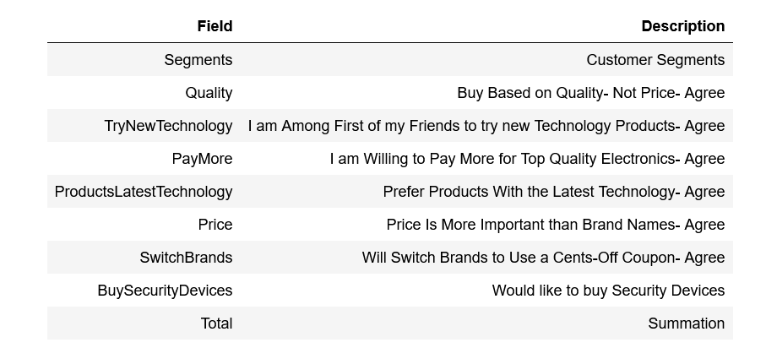
Customer Characteristics

Slide 9
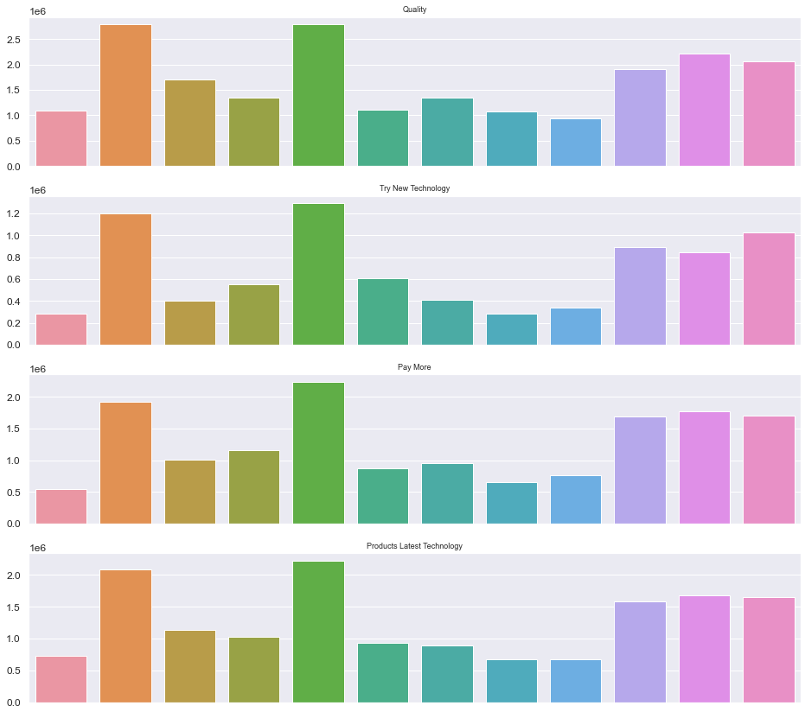

Slide 10
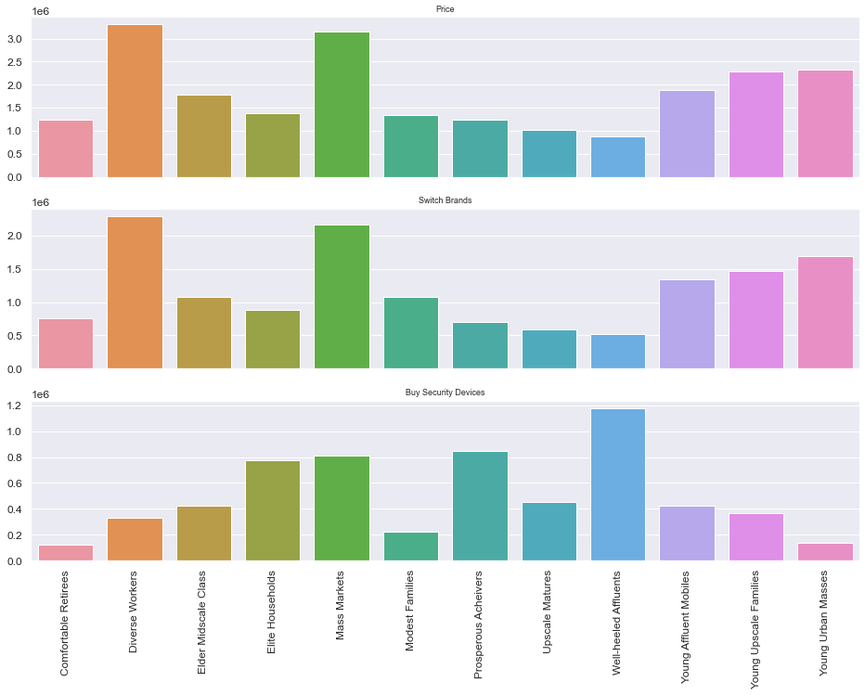

Slide 11
Customer Target Groups
Diverse Workers,
Mass Markets
Young Affluent Mobiles
Young Urban Masses
Young Upscale Families

Slide 12
4
Targeting Strategy

Slide 13
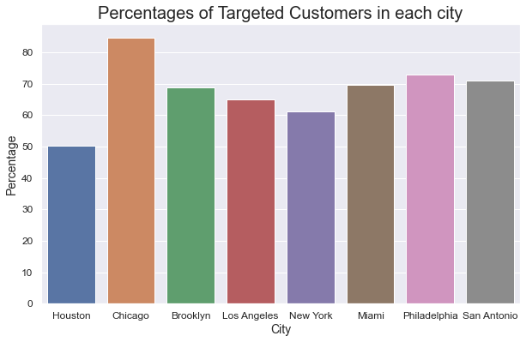
Cities Analysis

Slide 14
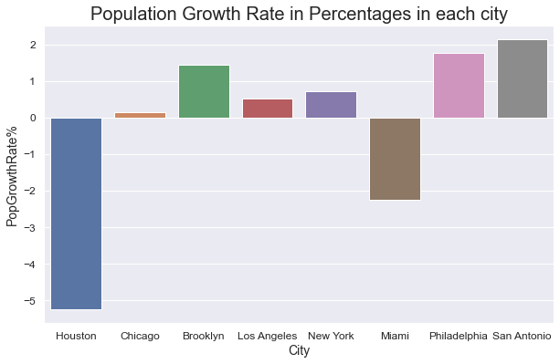
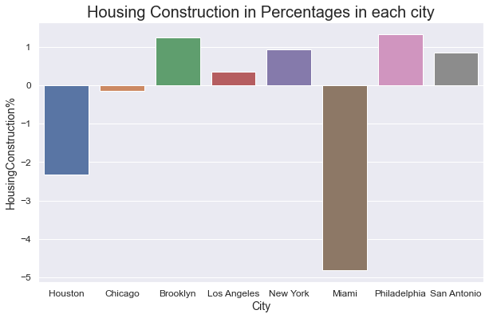
Cities Analysis

Slide 15
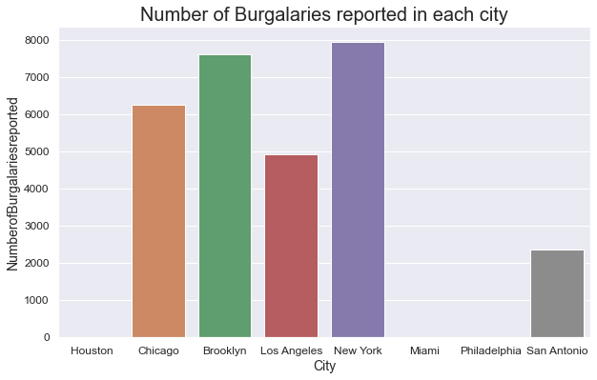
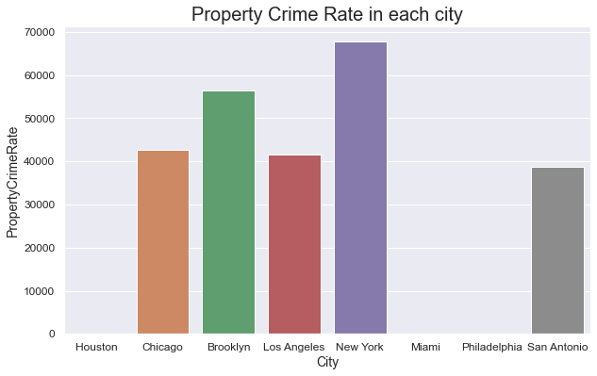
Cities Analysis

Slide 16
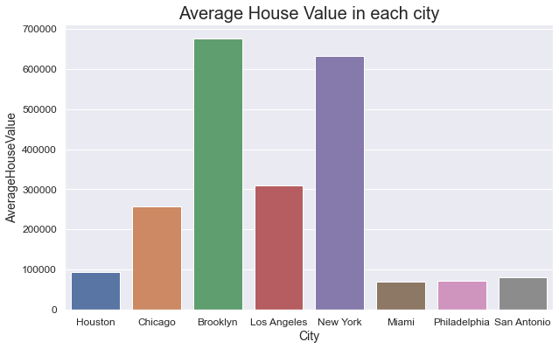
Cities Analysis

Slide 17
Strategy checklist
 | %Customers | %Crimerate | House value
Minimum 60%?
Crime Rate >3000?
House Value >300k?

Slide 18
Thanks!
Do you have any questions?
email@pwc.com
+00 000 000 000
pwccompany.com
Please keep this slide for attribution

